Slide 1
THE KINGDOM PROTISTA

Slide 2
A) SUBKINGDOM PROTOZOA
(first animals)
- EUKARYOTIC, UNICELLULAR, HETEROTROPHS
- PROTOZOA ARE CLASSIFIED BY THEIR METHOD OF MOTILITY

Slide 3
1. Phylum Sarcodina
- use pseudopods for motility
- Naegleria fowleri
- Entamoeba histolytica

Slide 4

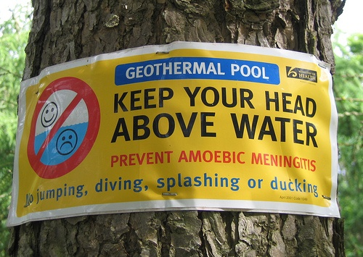

Slide 5
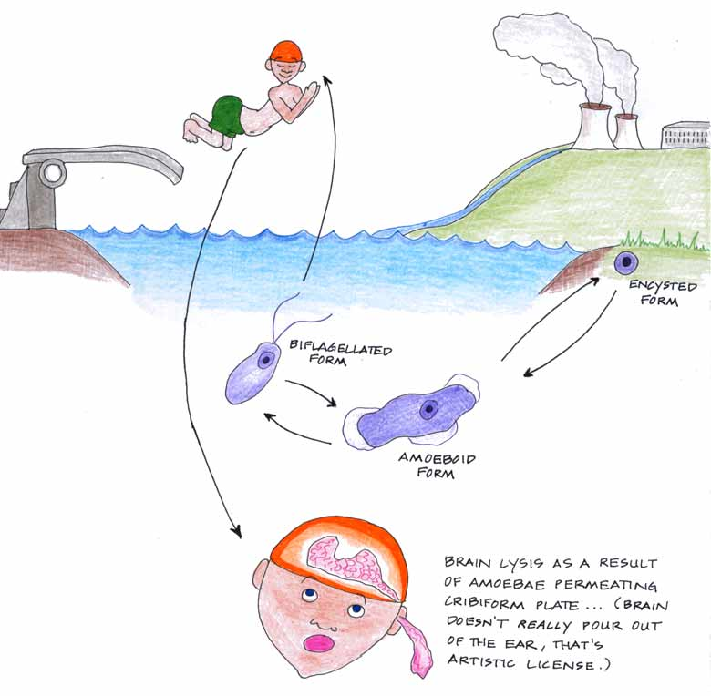
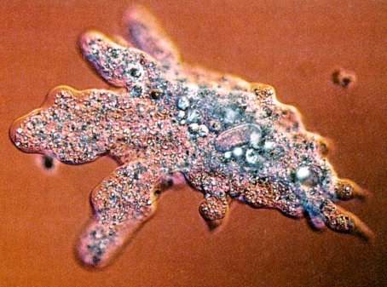

Slide 6
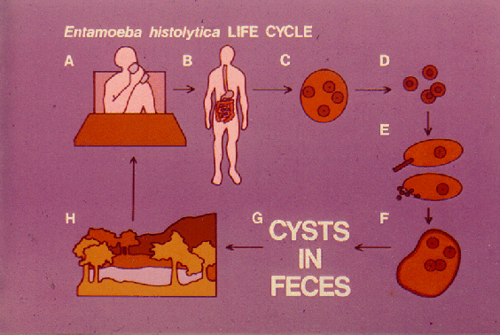

Slide 7
2. Phylum Mastigophora
- use flagella for motility
- Trichomonas vaginalis
- Giardia lamblia

Slide 8
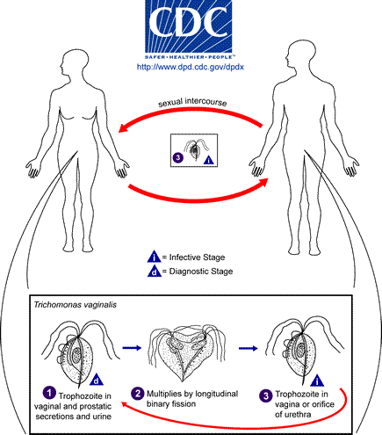
Trichomonas vaginalis

Slide 9
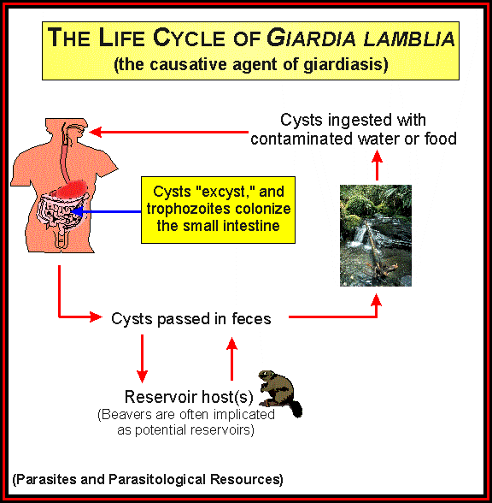

Slide 10
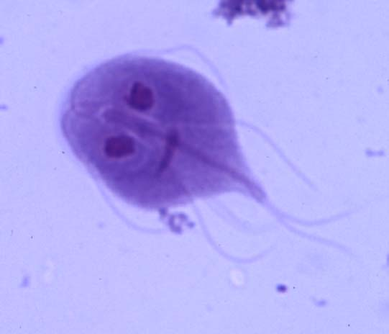
Giardia lamblia

Slide 11
3. Phylum Ciliophora
- use cilia for motility
- Paramecia
- Balantidium coli

Slide 12
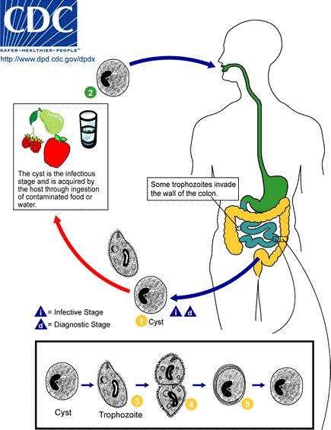
Balantidium coli

Slide 13
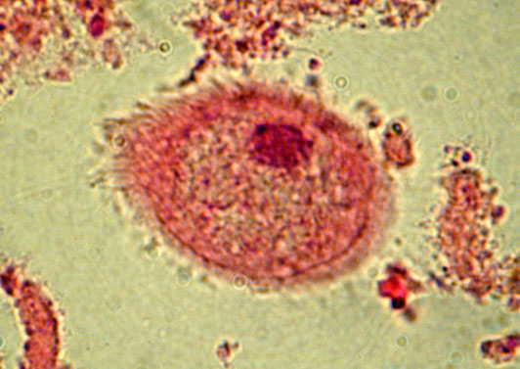

Slide 14
4. Phylum Apicomplexa
- they have no independent means of motility
- the only class in the phylum is the class
Sporozoa (they are often called sporozoans)
- Plasmodium spp.
- Toxoplasma gondii
- Cryptosporidium parvum

Slide 15
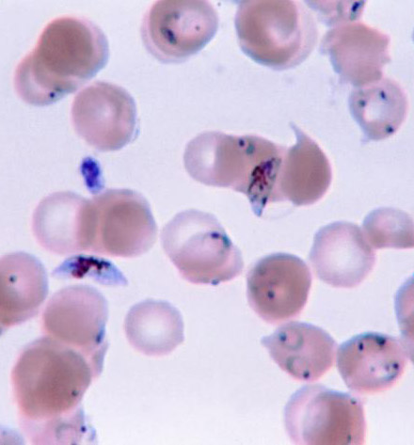
Plasmodium spp.
- trophozooites in RBC’s cause malaria

Slide 16
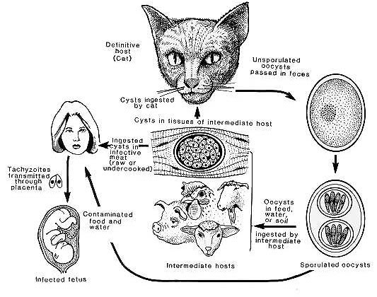
Toxoplasma gondii

Slide 17
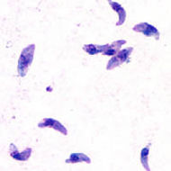
Toxoplasma gondii

Slide 18
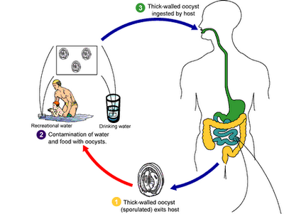
Cryptosporidiosis – Cryptosporidium parvum

Slide 19

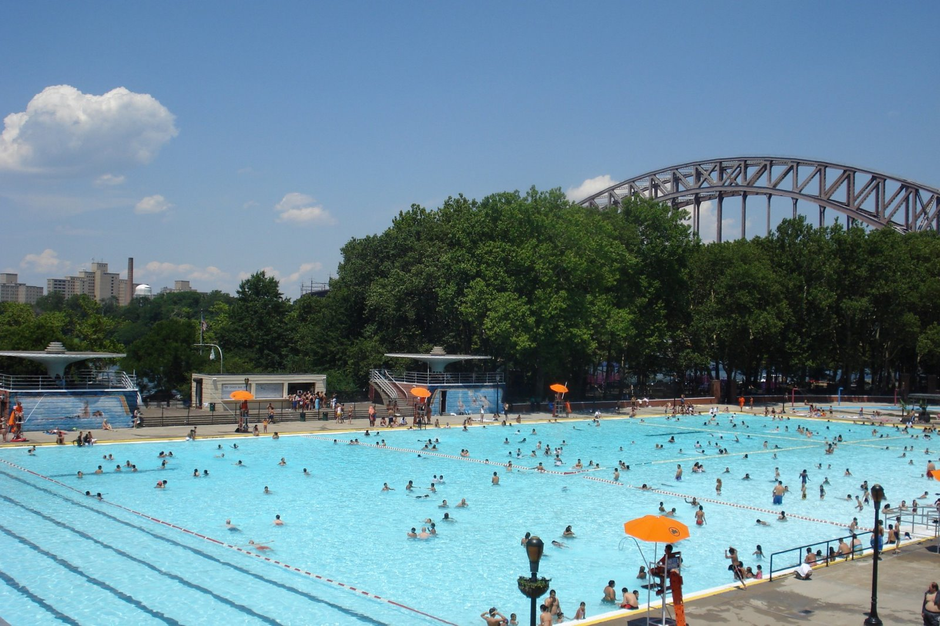

Slide 20
B) SUBKINGDOM ALGAE
(first plants)
- EUKARYOTIC, UNICELLULAR (OR COLONIAL),
AUTOTROPHS
- ALGAE ARE CLASSIFIED BY THEIR PIGMENTS

Slide 21
1. Green algae are theorized to be the ancestors of land plants.
2. Red algae are the source of agar.
3. Brown algae include kelp and other large ocean “seaweeds.”
4. Golden algae include diatoms, which produce massive amounts of O₂ gas
5. Fire algae include dinoflagellates responsible for producing “red tides,” they can show bioluminescence
6. Euglena can be autotrophs OR heterotrophs

Slide 22

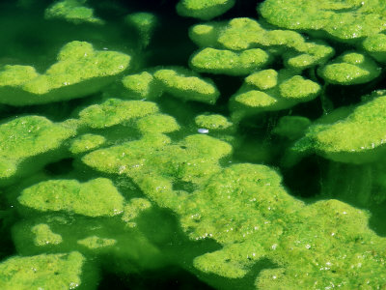

Slide 23
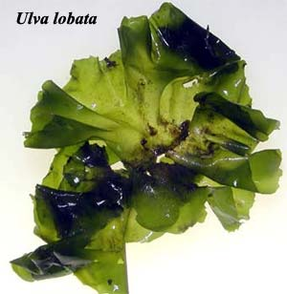

Slide 24
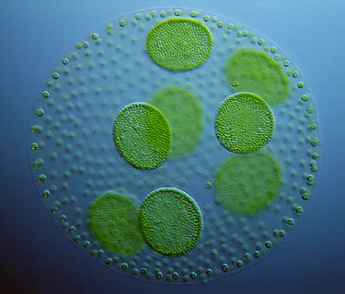

Slide 25
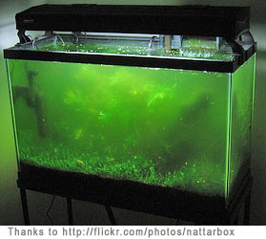

Slide 26

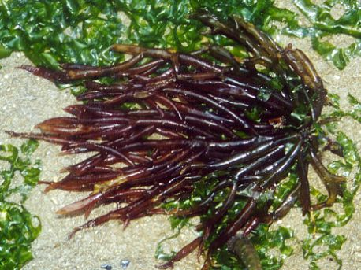
Red algae
Agar agar

Slide 27
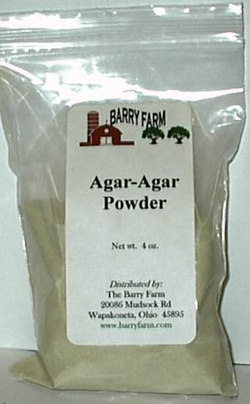

Slide 28
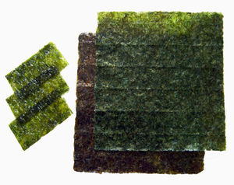
Nori – sushi wrap (red algae)

Slide 29
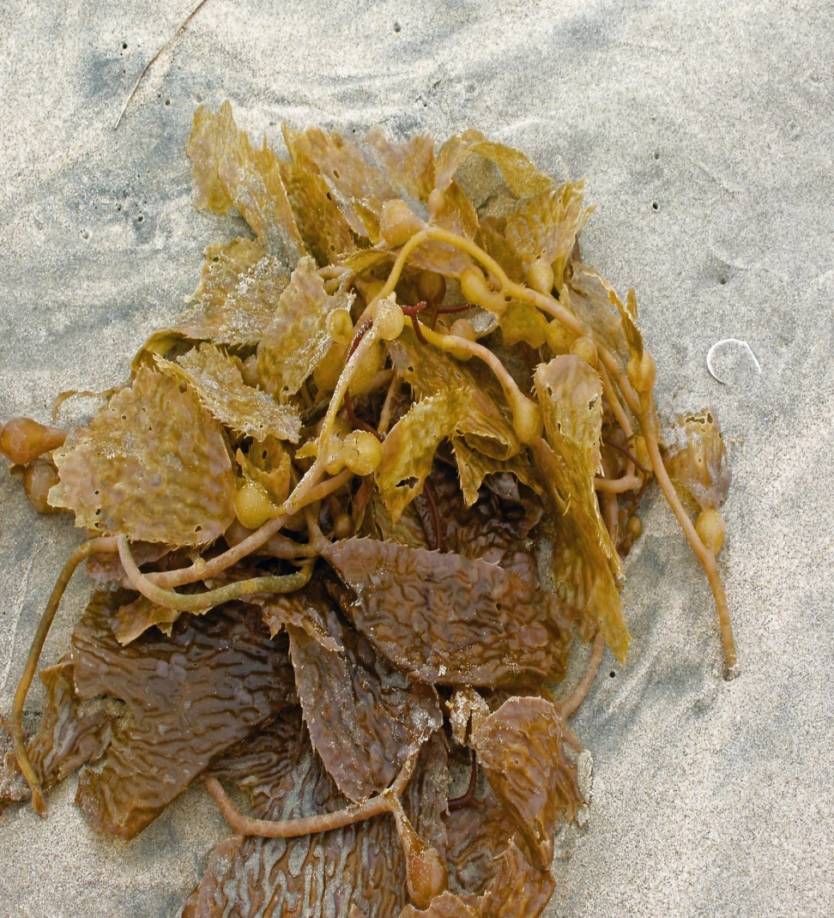
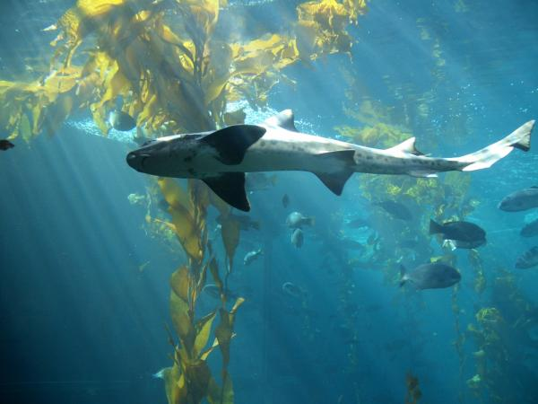
Brown algae - kelp

Slide 30
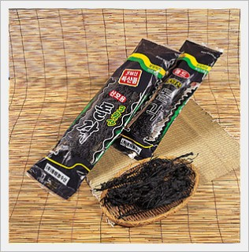
Edible brown algae

Slide 31
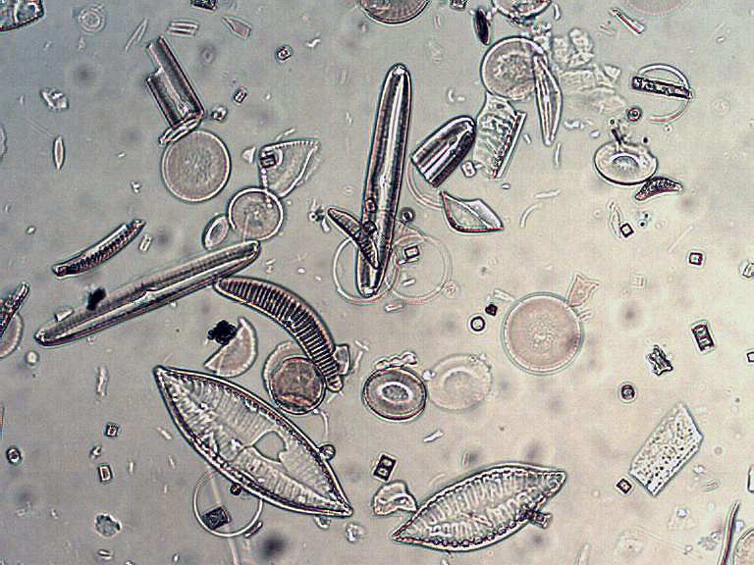
Golden algae - diatoms

Slide 32
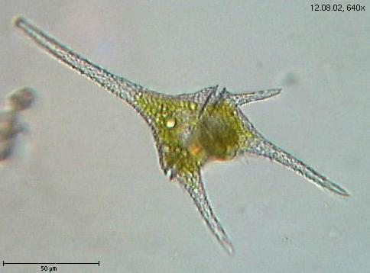
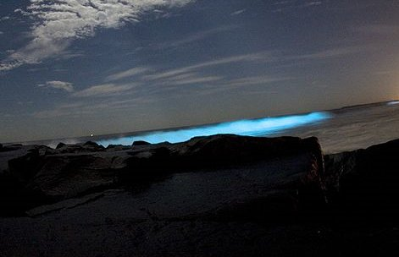
Fire algae
Biobay.com
a dinoflagellate
bioluminescence

Slide 33
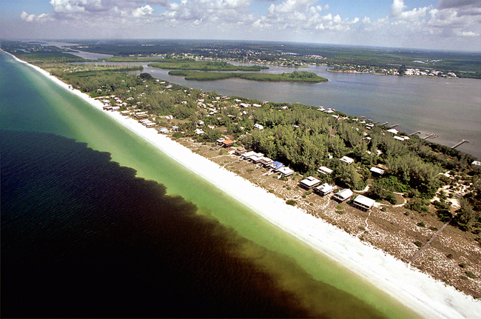
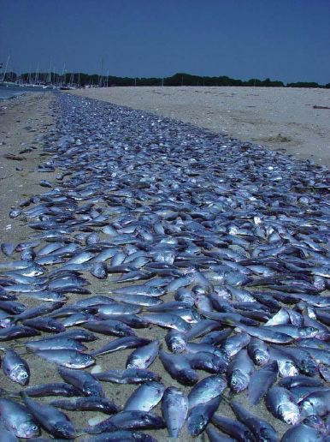
Florida red tide
Dead fish due to red tide

Slide 34
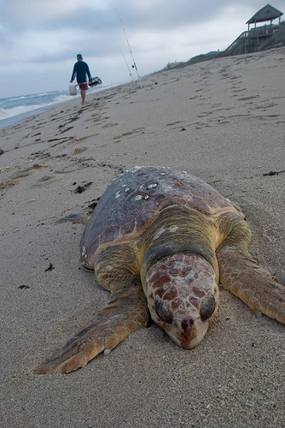
Dead sea turtle due to red tide

Slide 35
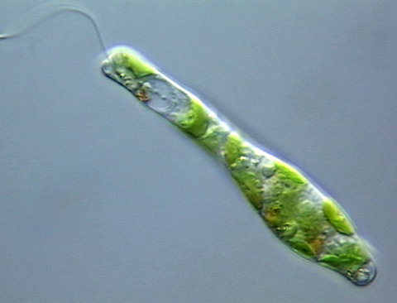
Euglena

Slide 36
THE KINGDOM FUNGI

Slide 37
Fungi are: a) important decomposers b) they produce antibiotics c) serve as a source of food mushrooms, truffles, blue cheese, yeast used to make beer, bread and wine

Slide 38
Diseases caused by fungi :
MYCOSES or MYCOTIC INFECTIONS
Dermatomycoses are fungal infections of the skin.

Slide 39
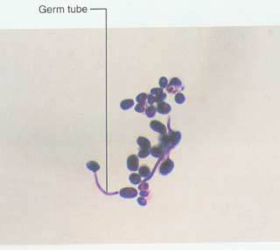
Superficial dermatomycoses a) candidiasis: Candida albicans (yeast)
- oral (thrush) and vaginal yeast infections

Slide 40
b) Ringworm (tinea)
- due to any of the following genera:
Trichophyton
Microsporum
Epidermophyton
- from where do humans get ringworm?

Slide 41
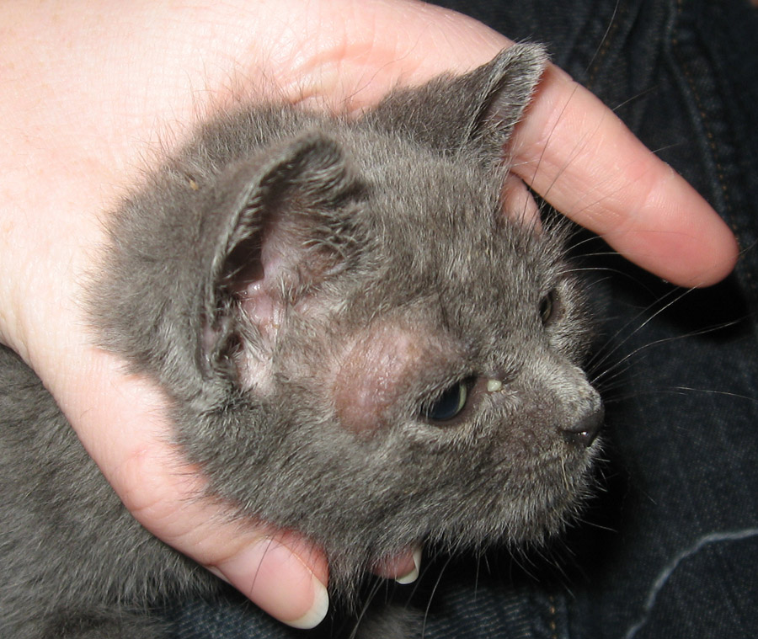
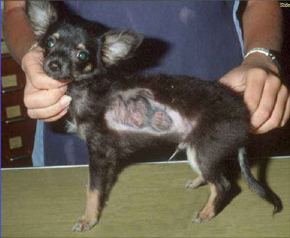
One source of ringworm is from animals.

Slide 42
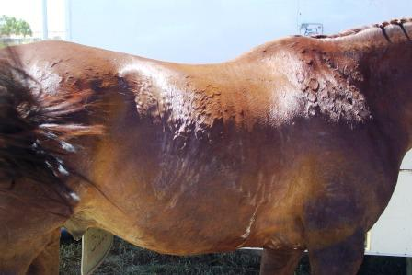

Slide 43
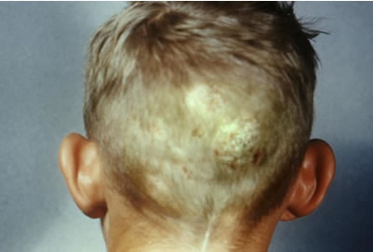
Tinea capitis – ringworm of the head and scalp

Slide 44
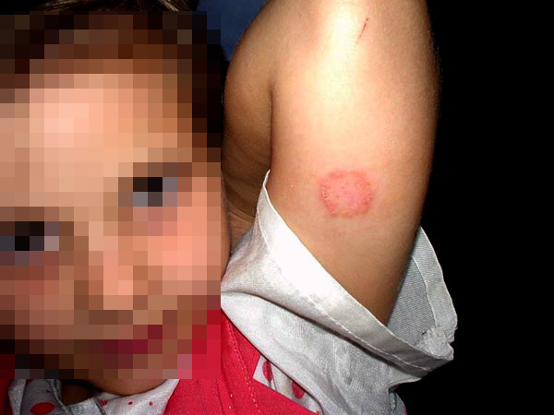
Tinea corporis – ringworm of the body

Slide 45
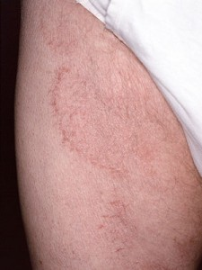
Tinea cruris – ringworm of the groin (jock itch)

Slide 46
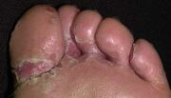
Tinea pedis – athlete’s foot (ringworm of the foot)

Slide 47
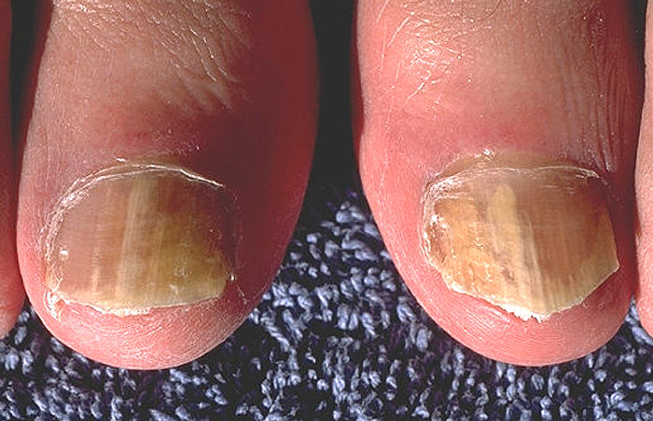
Tinea unguium – ringworm of the nails

Slide 48

Ringworm can be diagnosed using Sabouraud’s Dextrose Agar.

Slide 49
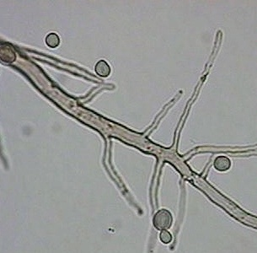
Ringworm can be diagnosed using skin scrapings cleared with KOH on a wet mount to look for fungal hyphae.

Slide 50
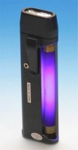
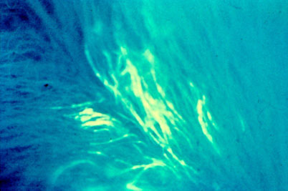
Ringworm can be diagnosed using a Wood’s lamp.

Slide 51
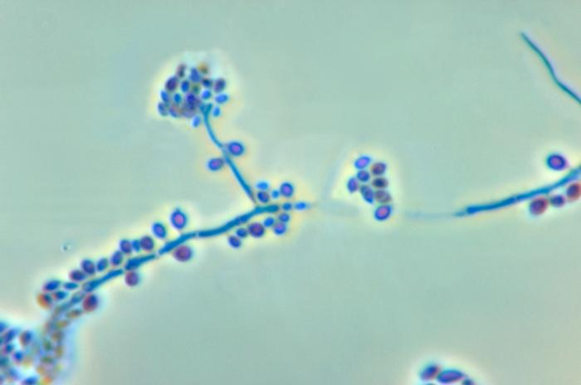
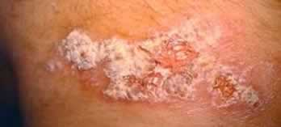
Subcutaneous mycoses
- Sporothrix schenkii

Slide 52
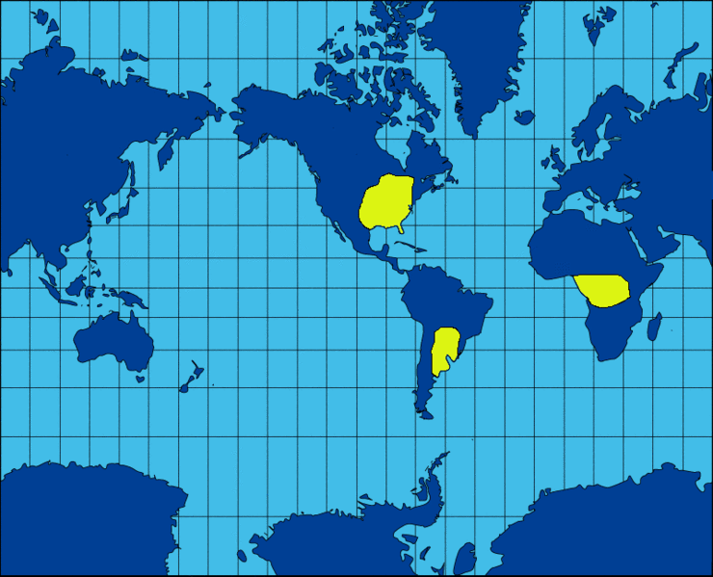
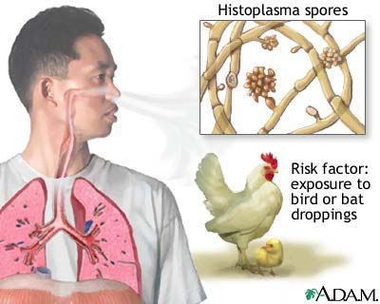
Deep systemic mycoses
- Histoplasma capsulatum (histoplasmosis) – commonly found where there is damp soil and where bird and bat droppings occur.
- Cryptococcosis, Blastomycosis, Coccidiodomycosis

Slide 53
THE ANIMAL KINGDOM

Slide 54
A. HELMINTHS (worms)
- Flatworms (phylum Platyhelminthes)
- tapeworms (human) how do humans get tapeworms?
- liver and lung flukes (human)

Slide 55
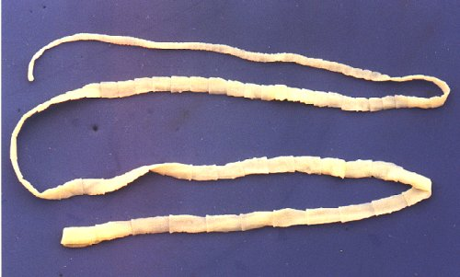
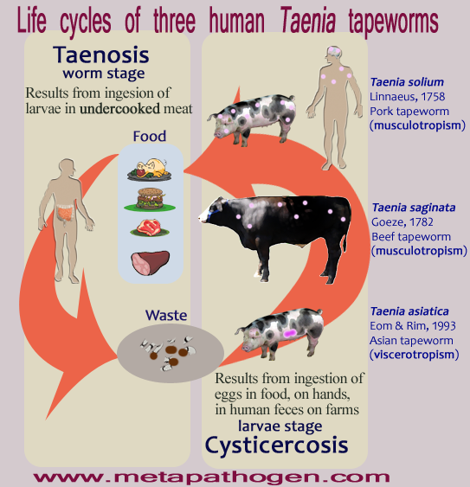
Human Tapeworms

Slide 56
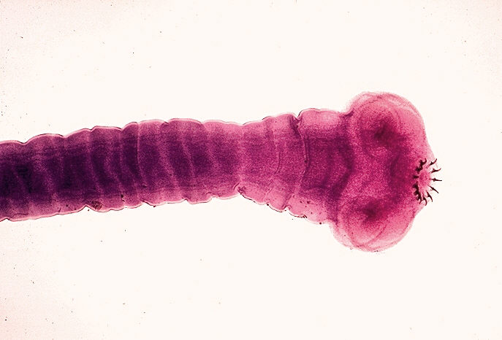


Slide 57


HUMAN LUNG FLUKE

Slide 58

Crustaceans are a good source of lung fluke infestation.

Slide 59
- Roundworms (phylum Nematoda)
- pinworms (human)
Enterobius vermicularis anal to oral route of transmission
- hookworms (human) larva can come from soil and penetrate skin visceral and cutaneous larva migrans
- heartworms (dogs and cats) mosquito vector

Slide 60


Human Pinworms

Slide 61


Slide 62


Human Hookworms

Slide 63


Hookworm egg
Cutaneous larva migrans

Slide 64


Heartworms (dogs and cats)

Slide 65


Adult heartworms infest the chambers of the heart
Microscopic heartworm microfilariae (larva) in blood sample

Slide 66


- Segmented worms (phylum Annelida)
- leeches (medicinal)
Leeches contain an anticoagulant and anesthetic in their saliva
Does one of these leeches have your name on it?

Slide 67
B. ARTHROPODS
- many arthropods act as vectors of infectious disease:

Slide 68
a) Plasmodium vivax and other Plasmodium species
- Anopheles mosquitoes are biological vectors of these protozoa that cause MALARIA
- quinine derivative drugs are the tx of choice but are becoming less effective due to drug resistant stains of the protozoa
- insecticide resistant mosquitoes strains are also developing
- a vaccine has been sought and may be available in the future
- chills, fever, headache, vomiting, death

Slide 69


Female Anopheles

Slide 70


Malaria kills an estimated 1 million people every year.

Slide 71

Bed nets are currently one of the best protections against malaria.

Slide 72
b) Borrelia burgdorferi
- the etiologic agent of LYME DISEASE
- transmission occurs through the bite of a deer tick
- a classic bull’s eye rash may be seen after being bitten by a tick
- get prompt antibiotic treatment!

Slide 73


Slide 74


Know how to remove a tick.

Slide 75

Bull’s eye rash from Lyme disease

Slide 76
c) Rickettsia rickettsii
- etiologic agent of Rocky Mountain Spotted
Fever (RMSF)
- vector is the tick
- small animals act as reservoirs
- most cases occur in the eastern and southeastern U.S.
- sudden headaches, fever, rash when in contact with ticks and dogs; may lead to death when untreated

Slide 77


American dog tick
Skin rash associated with RMSF

Slide 78


Slide 79
d) Rickettsia prowazekii
- etiologic agent of epidemic TYPHUS
- the vector is the human body louse
- high fever, frontal headache, muscle pain followed by a rash
- common during wars and in areas where poverty and famine exist

Slide 80


Human body louse
Typhus rash

Slide 81


Typhus is common in conditions of overcrowding and poor hygeine
Fumigation for lice

Slide 82


Slide 83
e) Yersinia pestis
- etiologic agent of the PLAGUE
- vector is the rat flea
- the term “black” plague comes from the black spots patients exhibit on their skin that come from clogged and broken capillaries
- “black”, pneumonic and bubonic plague all comes from the same bacteria
- there is a vaccine with variable protection

Slide 84


The plague doctor

Slide 85


Slide 86


Bubonic plague
“Black” plague

Slide 87


Slide 88
f) Viral Encephalitis
- St Louis, Eastern Equine (EEE), Western Equine
(WEE), Venezuelan Equine (VEE) and
West Nile occur in the U.S.
- vector is the mosquito
- St Louis is most common in the U.S.
- horses get viral encephalitis and have a vaccine
- “sentinel” test chickens and rabbits exist in cages throughout the state to detect outbreaks
- most people recover, the elderly and very young are most at risk

Slide 89



Slide 90


Slide 91



Slide 92
g) Other ARBOVIRUSES
- YELLOW FEVER is spread by Aedes aegyptii mosquito vectors and other mosquitoes
- there is a yellow fever vaccine often required for travelers from yellow fever infected countries
- DENGUE FEVER is also caused by Aedes aegyptii mosquito vectors
- there is no vaccine currently

Slide 93


Yellow Fever

Slide 94


Dengue Fever

Slide 95


Slide 96
h) Trypanosoma cruzi
- etiologic agent of CHAGA’S DISEASE
- vector is the reduviid bug (“kissing bug”)
- found in central and south America
- this protozoan affects the circulatory system

Slide 97



Slide 98


Romana’s sign
Cardiovascular effects

Slide 99
i) Trypanosoma brucei
- etiologic agent of African Sleeping Sickness
- vector is the tsetse fly
- prophylactic drugs are not of much use

Slide 100


Tsetse fly
Trypanosomes in blood

Slide 101


Slide 102


Slide 103
SCABIES
- Sarcoptes scabei
- intense pruritis (itch) of the skin as mites burrow and lay eggs

Slide 104


Slide 105
PEDICULOSIS
- Pediculus humanis human head and body lice
- Phthirus pubis pubic lice

Slide 106



Slide 107

Human head louse – “nit picking”

Slide 108


Human body lice
Pubic lice

Slide 109
Watch the following slide presentation on insects that live with you all the time. ☺ http://www.pbs.org/wgbh/nova/nature/bugs-that-live-on-you.html
Click on “launch interactive” to view the presentation.

Slide 110
Viruses
The “snot” lecture ☺

Slide 111
COLDS INFLUENZA
MUMPS RUBELLA (GERMAN MEASLES)
POLIOMYELITIS RUBEOLA (RED MEASLES)
CHICKEN POX SMALLPOX
RABIES WARTS (INCLUDING HPV)
HERPES HEPATITIS
MONONUCLEOSIS HIV

Slide 112
Louis Pasteur coined the term “virus” which means poison in latin.
All types of cells appear to have viruses that can affect them.
Are viruses alive?
Although they can reproduce and evolve, they don’t share the other characteristics of living things, especially since VIRUSES ARE NOT MADE OF CELLS!

Slide 113
Viruses are obligate intracellular parasites.
Viruses are very species and cell type specific:
- usually a virus infects one or two closely related species of organisms and typically only certain cells in those organisms.
ANTIBIOTICS ARE USELESS AGAINST VIRUSES since viruses have no cell parts, antibiotics (which attack cell parts) don’t destroy viruses.

Slide 114
To see a virus we need an electron microscope.
Each individual virus particle is called a VIRION.

Slide 115

All virions contain a proten coat (capsid) and either DNA or RNA but never both; some viruses may also be enveloped.

Slide 116


Coronavirus
Influenza

Slide 117


HIV
Rabies

Slide 118
HOW DO VIRUSES REPLICATE?
- in bacteria there are two general cycles that viruses take to cause infections and disease a) the lytic cycle is acute and rapid b) the lysogenic cycle is chronic and prolonged

Slide 119
The LYTIC CYCLE is when a virion attaches to a bacterial cell, invades, takes over the cell to produce more virions and then quickly lyses (bursts) the cell releasing viral progeny (offspring). a) attachment b) injection of DNA or RNA c) viral genome causes bacterial cell to make new virions d) lysis and death of the host cell to release virions

Slide 120

The Lytic Cycle of Viral Reproduction

Slide 121
The LYSOGENIC CYCLE is when a virion invades the host cell and the viral genetic material becomes incorporated into the host genetic material; where it is replicated and can lie dormant for generation after generation of binary fission. Stresses to the cell cause the prophage to remove itself from the chromosome association causing the lytic cycle to occur in the infected cell.

Slide 122

The Lysogenic Cycle of Viral Reproduction

Slide 123

A prophage is the viral DNA when it is inserted into the host cell’s genetic material; in animal cell viruses this same phenomenon is termed a provirus.

Slide 124
YouTube video of influenza attack http://www.youtube.com/watch?v=Rpj0emEGShQ&feature=player_embedded

Slide 125
In humans, viruses can also follow a short or long course of infection and presentation of signs and symptoms.
- animal viruses that persist for a long time are called latent viruses (the term provirus replaces the word prophage when referring to animal cell viruses, such as HIV) a) herpes simplex is latent b) herpes zoster (VZV) is latent

Slide 126

Herpes simplex I- cold sores/fever blisters

Slide 127

Herpes is a latent virus that lingers in the body, eruptions occur usually due to various forms of stress.

Slide 128

Herpes simplex 2 - genital herpes

Slide 129

Herpes keratitis- corneal infection with herpes simplex

Slide 130


Shingles is the latent form of chicken pox, both are caused by the same virus HHV3
Shingles on face
Shingles on abdomen

Slide 131
Some viruses are ONCOGENIC (cancer causing)
Epstein Barr virus (HHV4) causes Burkitt’s lymphoma.
Hepatitis B and C viruses can lead to liver cancer.
Human Papilloma virus causes cervical cancer.

Slide 132


Mononucleosis is often called the “kissing disease” although sharing drinking vessels and sneezing are often more common methods of transmission
Monospot rapid test

Slide 133


Slide 134

Splenomegaly is common with “mono”

Slide 135


Hepatitis B can be transmitted in other ways besides sex; there is a vaccine to protect people from the virus

Slide 136

Hepatitis B global distribution

Slide 137


Hepatitis is an inflammation of the liver that can lead to cirrhosis and liver cancer

Slide 138


Hepatitis C is also oncogenic but there is NO vaccine that can be used to prevent this disease.

Slide 139

Hepatitis C Global Distribution

Slide 140


Human Papilloma Virus (Genital warts)

Slide 141
It appears that there are even smaller infectious particles than even viruses!
VIROIDS are naked pieces of RNA known to infect plants.
PRIONS are proteinaceous infectious particles that cause diseases like BSE, vCJD, kuru, and scrapie.

Slide 142

Viroids affecting hops, citrus and nectarines

Slide 143

Prions are denatured proteins that apparently can cause infections and disease

Slide 144

Bovine spongiform encephalopathy (BSE) or “mad cow disease” – these cows are often one source of “downer cows”

Slide 145

Humans eating beef tainted with BSE prions can develop variant Creutzfeldt-Jakob disease (vCJD)

Slide 146

Kuru was a disease that occurred in the native tribes of New Guinea, when the victorious tribes would cannibalize the losers; the nervous tissue was infected with prions which would infect those eating the brain.

Slide 147

Scrapie, due to a prion, causes “downer sheep”

Slide 148


Slide 149
Learning objectives for Packet 2 and 2B:
1. Explain the scientific theory concerning the origin of life on earth and how eukaryotic cells theoretically arose from prokaryotic cells.
2. Be able to classify microorganisms by kingdom and know the text microbiologists refer to for bacterial classification.
3. Be able to draw, define and explain the functions of the different parts of prokaryotic and eukaryotic cells.
4. Know the purpose of the glycocalyx, cell wall, cell membrane as a part of a bacterial cell’s cell envelope.
5. Be able to draw and name the various shapes and arrangements of bacterial cells.
6. Explain the differences between the structures of gram + and gram – cell walls. Describe the specific effect penicillin and lysozyme have on bacterial cell walls.
7. Be able to explain the steps in the gram staining procedure and explain why each step is important to produce the final results.
8. Be able to explain the steps in the acid fast staining procedure and explain why each step is important to produce the final results; predict when you would want to do an acid fast stain on a patient sample.
9. Begin your knowledge of tuberculosis and be able to differentiate the purpose of the PPD injection versus the BCG injection.
10. Be able to draw a cell membrane and compare and contrast the processes of diffusion, osmosis, facilitated diffusion, active transport and phagocytosis.

Slide 150
11. Explain your knowledge about a cell’s protoplasm (cytoplasm) and contrast how bacterial intracellular structure differs from that of eukaryotic cells.
12. Compare and contrast the chromosomes of prokaryotes and eukaryotes, be able to explain the function of plasmids and the processes of binary fission, conjugation, transformation and transduction.
13. Explain the differences between prokaryotic and eukaryotic ribosomes.
14. Draw to identify flagellar arrangements in bacteria and be able to compare and contrast bacterial flagella from eukaryotic flagella.
15. Explain the significance of bacterial endospores and know what human pathogens are endospore producing; know how endospore producing bacteria are stained.
16. In the kingdom Protista, know the subkingdoms and phyla of the microbes mentioned in the notes. Be able to discuss each of the microbes mentioned from the lecture packet notes.
17. In the kingdom Fungi, be able to discuss each of the fungi mentioned from the lecture packet notes.
18. In the kingdom Animalia, be able to discuss each worm infestation and insect- transmitted disease from the lecture packet notes.
19. Know which common human diseases are due to viral infections and be able to compare and contrast the lytic cycle of viral reproduction from the lysogenic cycle. Know why antibiotics are not recommended for viral infections.

Slide 151
20. Explain the anatomy of a virus and be able to discuss each viral infection mentioned in the lecture packet notes.
21. Be able to discuss which viruses are oncogenic.
22. Contrast viruses from viroids and prions and be able to discuss the prion-caused infections mentioned in the lecture packet notes.

